Slide 1

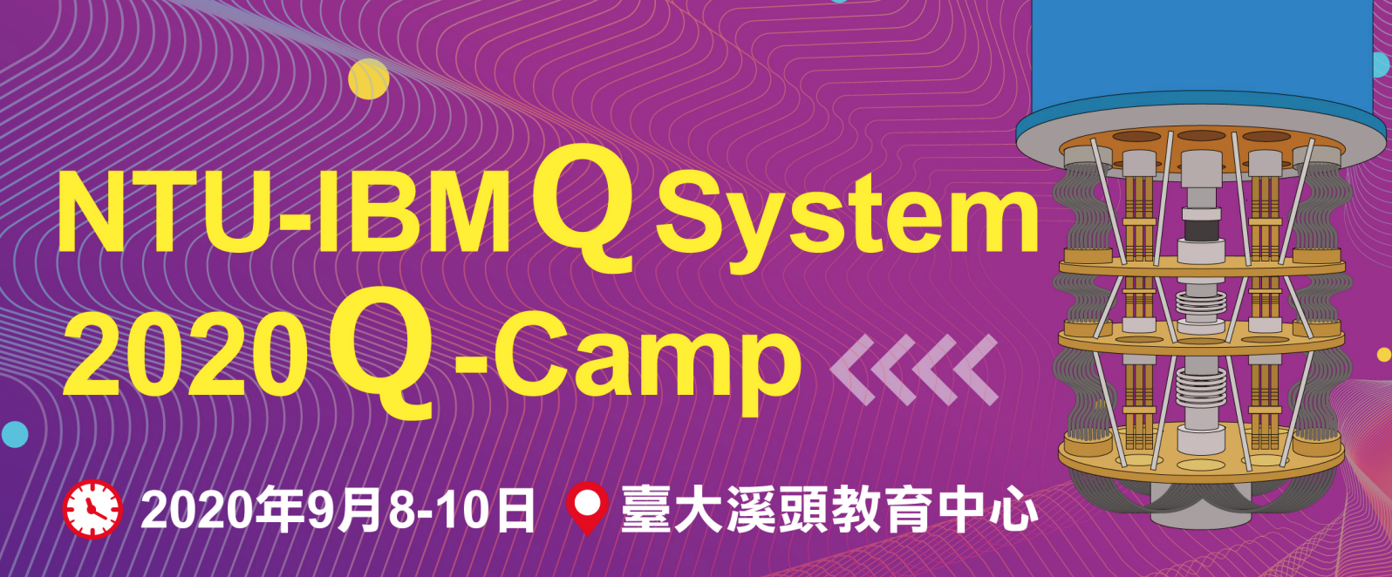
Wireless Vehicular Network
#22 Application of quantum optimization
Cheng-Yu Han, Belmiro Chu, Jing Yu Xu, Min-I Lee, Yan-Cheng Wei
Coach: Samanvay Sharma, Takashi Imamichi
http://www.free-powerpoint-templates-design.com
Notes:
Hello everyone. We are team 22. Our team focus on how to apply quantum optimization to improve our life

Slide 2
Q
How to improve our live with quantum computer?
Notes:
We researched a lot of field and finally, choose a field that has much potential and prospect. That is

Slide 3
Wireless
Vehicular Network
Notes:
Wireless sensor network

Slide 4
5G
Prevent collision
Locate pedestrian
Speed up the localization
Improve efficiency of the facility
Notes:
Which is a topic that belong to IOT internet of things. The motivation here is that, with robust wireless sensor network, vehicles can prevent collision and locate pedestrian so that the accident can be reduced and lives can be safed.

Slide 5


Assume each vehicle is able to send signal to each other and estimation the signal strength. With the signal strength, vehicle can estimate the distance of the the sensor. Therefore, it can estimate its position by formulating the problem to quadratic functions and solved using quantum optimization.
01
02
03
Sensor Distribution
Vehicle Localization
Data synchronization protocol
What can be solved by QC?
Notes:
We apply quantum optimization to the follow problem. Yes, we built 3 applications instead of 1. All the applications are associate with quantum computing.
First, sensor distribution
Second, vehicle localization
Third, data synchronization protocol

Slide 6
Assume each vehicle is able to send signal to each other and estimation the signal strength. With the signal strength, vehicle can estimate the distance of the the sensor. Therefore, it can estimate its position by formulating the problem to quadratic functions and solved using quantum optimization.
01
02
03
Sensor Distribution
Vehicle Localization
Data synchronization protocol
What can be solved by QC?
Notes:
Let’s start from the first application: sensor distribution

Slide 7
01
Sensor Distribution
Problem Type
Combinatory optimization problem
Method
Max-Cut
Quantum approximate Optimization Algorithm
Quantum Advantage
NP problem
Quantum speedup
Guerreschi, G.G., Matsuura, A.Y. QAOA for Max-Cut requires hundreds of qubits for quantum speed-up.
Sci Rep 9, 6903 (2019). https://doi.org/10.1038/s41598-019-43176-9

Slide 8
01
Sensor Distribution
Problem Type
Combinatory optimization problem
Method
Max-Cut
Quantum approximate Optimization Algorithm
Quantum Advantage
NP problem
Quantum speedup
Guerreschi, G.G., Matsuura, A.Y. QAOA for Max-Cut requires hundreds of qubits for quantum speed-up.
Sci Rep 9, 6903 (2019). https://doi.org/10.1038/s41598-019-43176-9
Notes:
That is, it is a partition of the graph's vertices into two complementary sets S and T, such that the number of edges between the set S and the set T is as large as possible. The problem of finding a maximum cut in a graph is known as the Max-Cut Problem.

Slide 9
01
Sensor Distribution
Problem Type
Combinatory optimization problem
Method
Max-Cut
Quantum approximate Optimization Algorithm
Quantum Advantage
NP problem
Quantum speedup
Guerreschi, G.G., Matsuura, A.Y. QAOA for Max-Cut requires hundreds of qubits for quantum speed-up.
Sci Rep 9, 6903 (2019). https://doi.org/10.1038/s41598-019-43176-9
Notes:
That is, it is a partition of the graph's vertices into two complementary sets S and T, such that the number of edges between the set S and the set T is as large as possible. The problem of finding a maximum cut in a graph is known as the Max-Cut Problem.

Slide 10
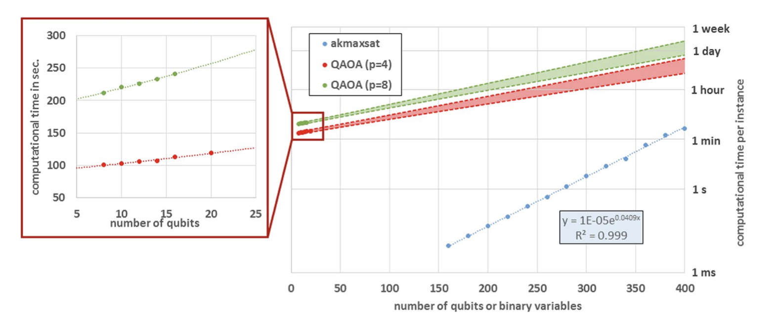
01
Sensor Distribution
Problem Type
Combinatory optimization problem
Method
Max-Cut
Quantum approximate Optimization Algorithm
Quantum Advantage
NP problem
Quantum speedup
Guerreschi, G.G., Matsuura, A.Y. QAOA for Max-Cut requires hundreds of qubits for quantum speed-up.
Sci Rep 9, 6903 (2019). https://doi.org/10.1038/s41598-019-43176-9
Notes:
With the help of quantum optimizer QAOA, if the number of qubits or binary variables

Slide 11

01
Sensor Distribution
$$H=−\underset{<i,j>}{∑}J_{ij}σ_{i}σ_{j}$$
Dynamically optimize the sensor distribution
01
Max-Cut
Choosing edges through Max-Cut
02
Cost Function
Mapping Hamiltonian into the form of Ising model
Optimization
03
Using Variational Quantum Eigensolver(VQE) to optimize the problem

Slide 12
Assume each vehicle is able to send signal to each other and estimation the signal strength. With the signal strength, vehicle can estimate the distance of the the sensor. Therefore, it can estimate its position by formulating the problem to quadratic functions and solved using quantum optimization.
01
02
03
Sensor Distribution
Vehicle Localization
Data synchronization protocol
What can be solved by QC?

Slide 13
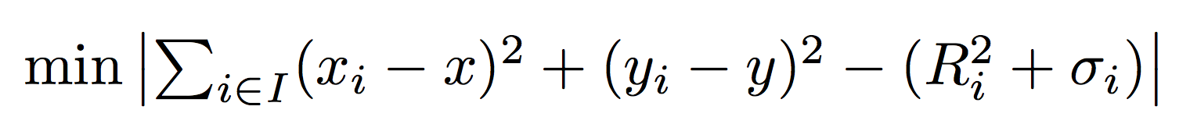
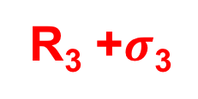
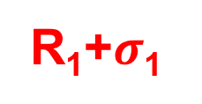

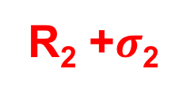
02
Vehicle Localization
(x₂,y₂)
(x, y)
R₂ +$σ$₂
Car’s position = (x, y)
Sensor’s position = (x_{i}, y_{i})
Sensor’s noise = $σ$_{i}
R₁+$σ$₁
R₃ +$σ$₃
(x₁,y₁)
(x₃,y₃)

Slide 14
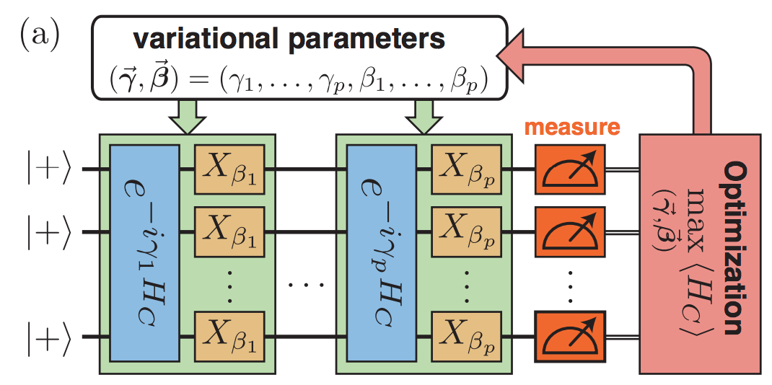
Quadratic Problem
QAOA
hybrid quantum-classical variational algorithm
designed to tackle combinatorial optimization problems
NP-hard problem
Can be mapping into QAOA (Quantum Approximate Optimization Algorithm)
arXiv:1812.01041v2

Slide 15
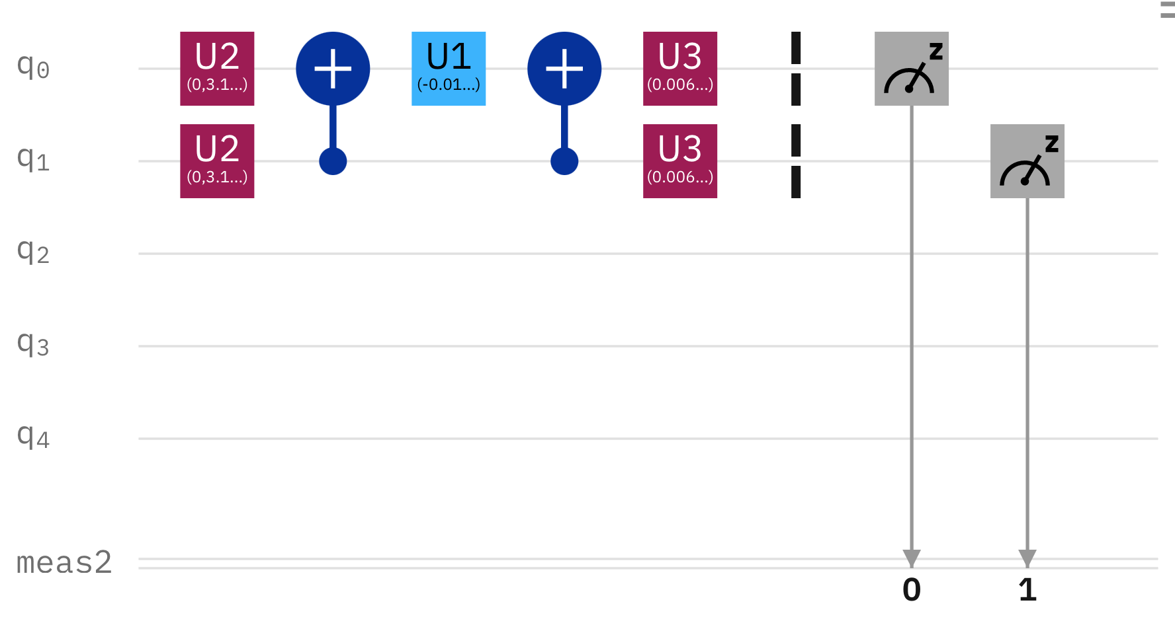
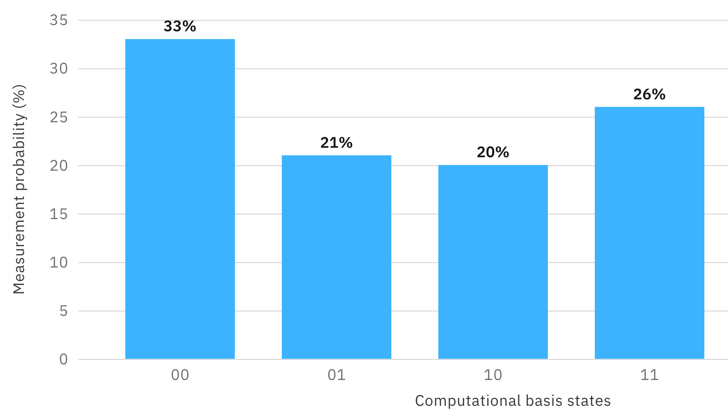
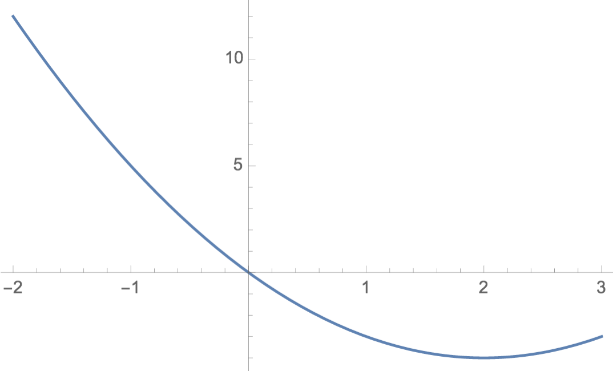
02
Vehicle Localization
Real Device Experiments
Vehicle
Position
Sensor
Position

Slide 16
Assume each vehicle is able to send signal to each other and estimation the signal strength. With the signal strength, vehicle can estimate the distance of the the sensor. Therefore, it can estimate its position by formulating the problem to quadratic functions and solved using quantum optimization.
01
02
03
Sensor Distribution
Vehicle Localization
Data synchronization protocol
What can be solved by QC?

Slide 17
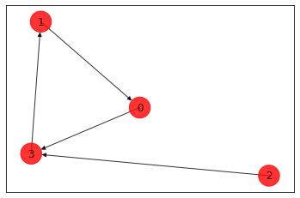
03
Data synchronization protocol
How to design routes from server to a number of sensor locations and back to the server?
NP hard problem
Combinatorial optimization
Map the resulting problem into an Ising Hamiltonian
Solved for N = 1 ~ 5

Slide 18
Demo

Slide 19
Conclusions
01
02
03
Sensor Distribution
Vehicle Localization
Data synchronization protocol

Slide 20
Future work
Solve multiple vehicles using QAOA
Improve placement of sensor network
Design pulse communication protocol
for time synchronization

Slide 21
Thank you for your attention!

